Slide 1


XAI with Machine Teaching when Humans Are
(Not) Informed about the Irrelevant Features
Brigt Arve Toppe Håvardstun¹, Cèsar Ferri², Jose Hernández-Orallo², Pekka Parviainen¹, and Jan Arne Telle¹
1: Department of Informatics, University of Bergen, Norway.
2: VRAIN, Universitat Politècnica de València, Spain.
Valencia, 2024
MT4H

Slide 2
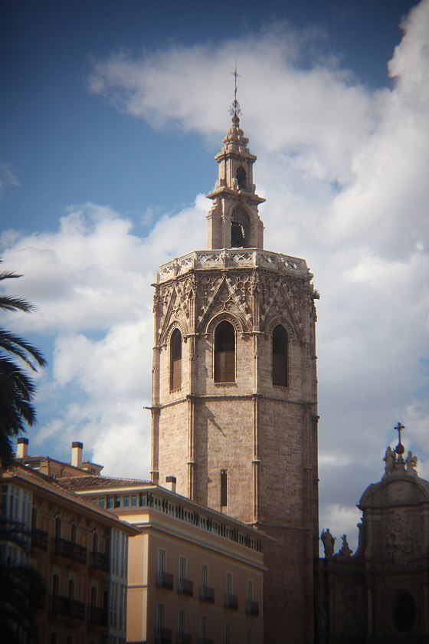
Introduction
Why
  AI makes decision, we need to understand
What
  Exemplar-based explanations, using Machine Teaching techniques.
This:
  Background
  Proposed framework
  Teaching various AIs
  Human survey
  Conclusion

Slide 3
Explainable AI
Global explanation - explain everything
Model agnostic - no matter what model
Exemple-based explanation

Slide 4
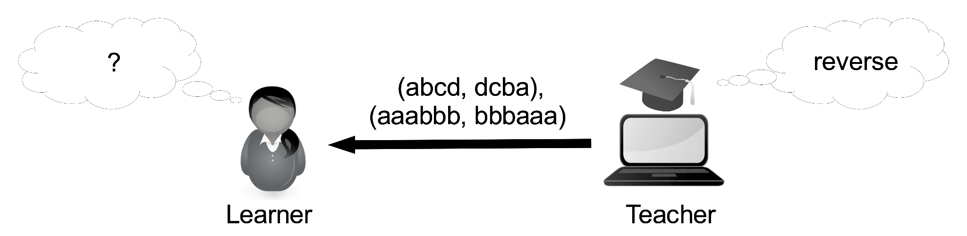
Machine Teaching
In PAC-learning the examples are randomly drawn. [VALIANT, 84]
In machine teaching, examples are carefully selected. Minimize number of examples needed. [Goldman&Mathias, 96]
Many models of machine teaching. [Zhu, 18], [Gao, 17],[Ferri, 22]

Slide 5
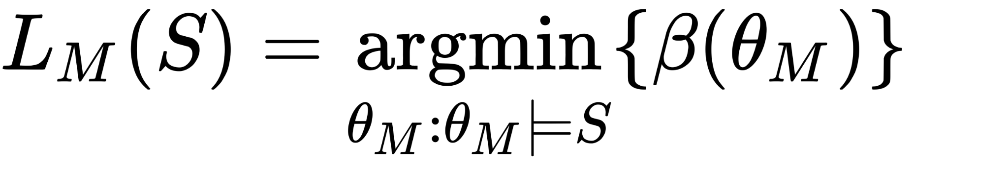
Teacher needs a model LM of the learner
What will the human do when shown a teaching set S like (abcd, dcba)?
Answer: use Occams Razor

Slide 6
Teacher needs a model LM of the learner
What will the human do when shown a teaching set S (like abcd, dcba)?
Answer: use Occams Razor
Goal for teacher: Find small S, such that human guess is close to correct

Slide 7
Framework

Slide 8
Framework
Teacher

Slide 9
Framework
Teacher
AI

Slide 10
Framework
Teacher
AI
Teaching Set

Slide 11
Framework
Teaching Size
Teacher
AI
Teaching Set

Slide 12
Framework
Teaching Size
1 - Fidelity
Teacher
AI
Teaching Set

Slide 13
Framework
Teaching Size
1 - Fidelity
Model of learner
Teacher
AI
Teaching Set

Slide 14
Framework
Teaching Size
1 - Fidelity
Model of learner
Learners guess
Teacher
AI
Teaching Set

Slide 15
What to teach?

Slide 16
Framework
AI

Slide 17
CNN
Boolean functions

Slide 18

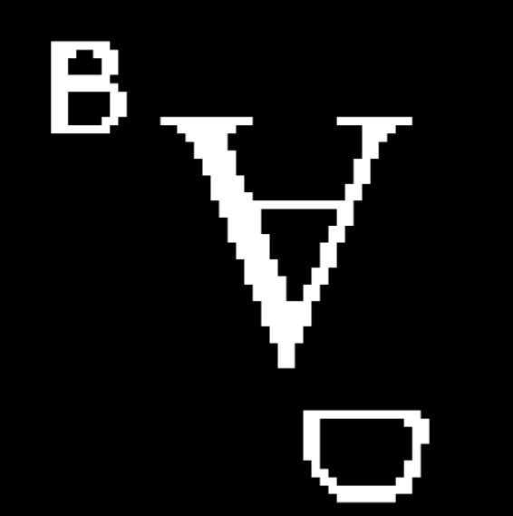
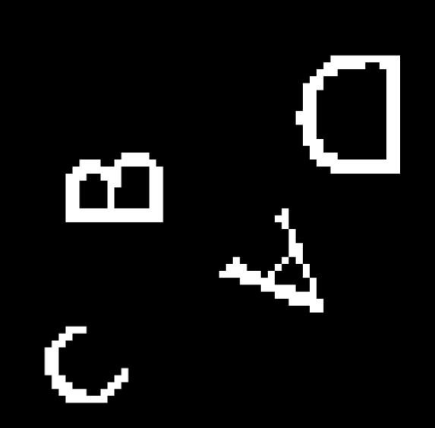
- Boolean function w/irrelevant features(letter-size, rotation, placement)
f(A,B,C,D) = not C
input
labels
1
1
0

Slide 19
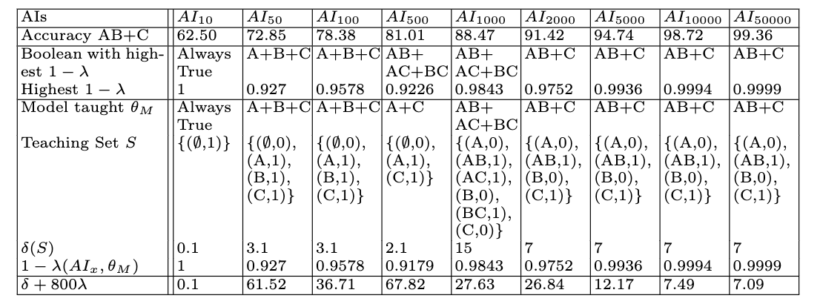
Training CNN w/irrelevant features
Trained on: AB+C
AI_{k} -> Traningset size k

Slide 20
Framework
AI

Slide 21
Framework
1 - Fidelity

Slide 22
Highest fidelity boolean expressions
Similarity measure
RMS-error

Slide 23
Highest fidelity boolean expressions
Similarity measure
RMS-error

Slide 24
Highest fidelity boolean expressions
Trained on: AB+C
Best fit: Something else

Slide 25
Framework
1 - Fidelity

Slide 26
Framework
Model of learner

Slide 27
Occam's Razor
Presence / absence
Find simplest matching boolean expression
  Fewest clauses
L_{M}(S)=A+B
,1
,0
L_{M}(S) is not something complicated!
,1

Slide 28
Model of humans guess

Slide 29
Model of humans guess

Slide 30
Taught model and highest fidelity

Slide 31
Taught model and highest fidelity

Slide 32
Taught model and highest fidelity

Slide 33
Framework
Teaching Size

Slide 34
Framework
Trade-off
Teaching Size

Slide 35
Teaching Size
Number of present letters
1
3²
4²

Slide 36
Big teaching sets for long expressions
Number of present letters

Slide 37
Taught model and highest fidelity

Slide 38
Taught model and highest fidelity

Slide 39
AI₅₀₀ differences to AI₁₀₀₀

Slide 40
AI₅₀₀ differences to AI₁₀₀₀

Slide 41
AI₅₀₀ differences to AI₁₀₀₀

Slide 42
AI₅₀₀ differences to AI₁₀₀₀

Slide 43
AI₅₀₀ differences to AI₁₀₀₀

Slide 44
Taught model and highest fidelity

Slide 45
Framework
Trade-off
Teaching Size

Slide 46
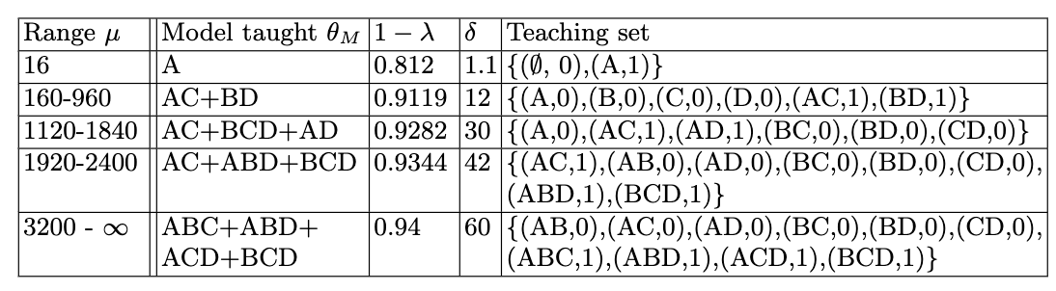
Varying μ values - targeted teaching
φ = AB+CD

Slide 47
Human user survey.
How to handle irrelevant features?
Dataset contaminated w/ irrelevant features(size, rotation, placement)
Our model of human is not perfect
How to handle irrelevant?

Slide 48
Human user survey.
How to handle irrelevant features?
Dataset contaminated w/ irrelevant features(size, rotation, placement)
Our model of human is not perfect
How to handle irrelevant?
  Nothing: Do nothing

Slide 49
Human user survey.
How to handle irrelevant features?
Dataset contaminated w/ irrelevant features(size, rotation, placement)
Our model of human is not perfect
How to handle irrelevant?
  Nothing: Do nothing
  Simplified: Remove irrelevant features from examples

Slide 50
Human user survey.
How to handle irrelevant features?
Dataset contaminated w/ irrelevant features(size, rotation, placement)
Our model of human is not perfect
How to handle irrelevant?
  Nothing: Do nothing
  Simplified: Remove irrelevant features from examples
  Informed: Inform user about irrelevant features

Slide 51
Human user survey.
How to handle irrelevant features?
Dataset contaminated w/ irrelevant features(size, rotation, placement)
Our model of human is not perfect
How to handle irrelevant?
  Nothing: 12
  Simplified: 17
  Informed: 13

Slide 52
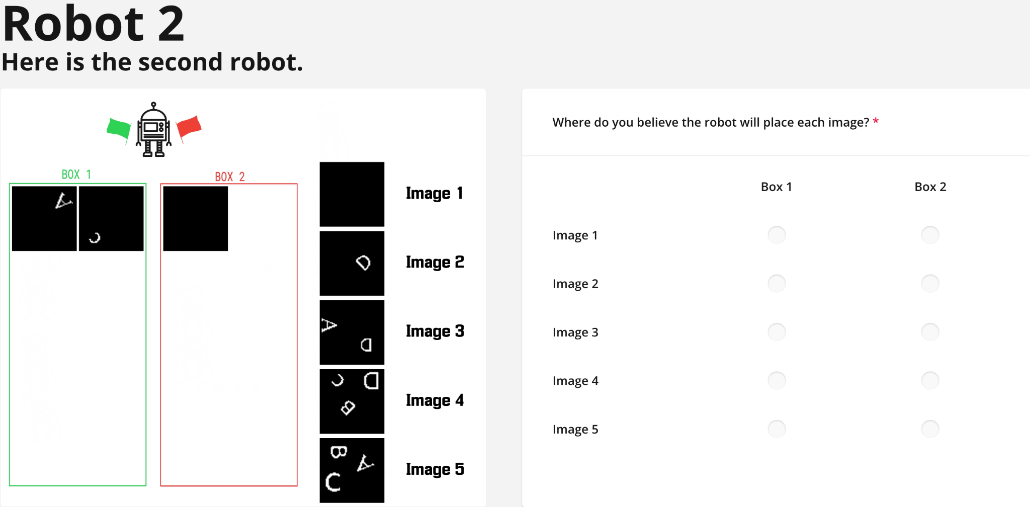
Nothing
Do nothing

Slide 53
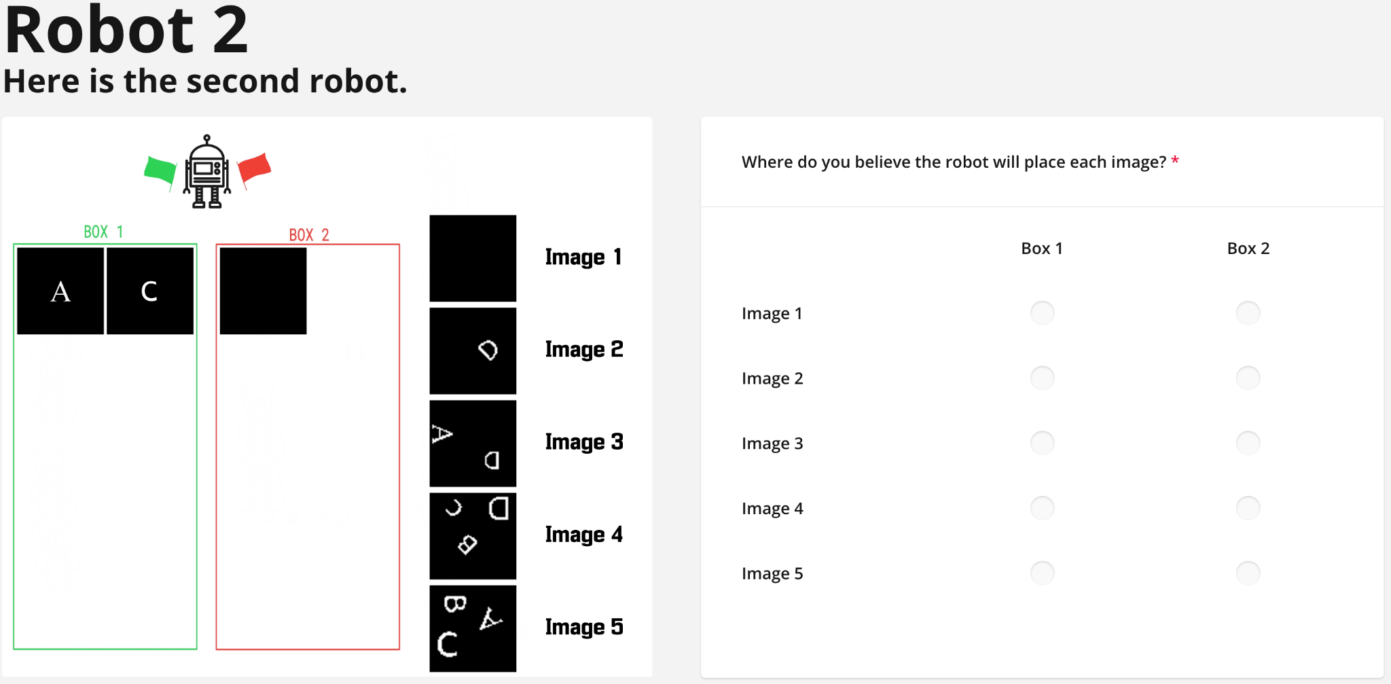
Simplified

Slide 54
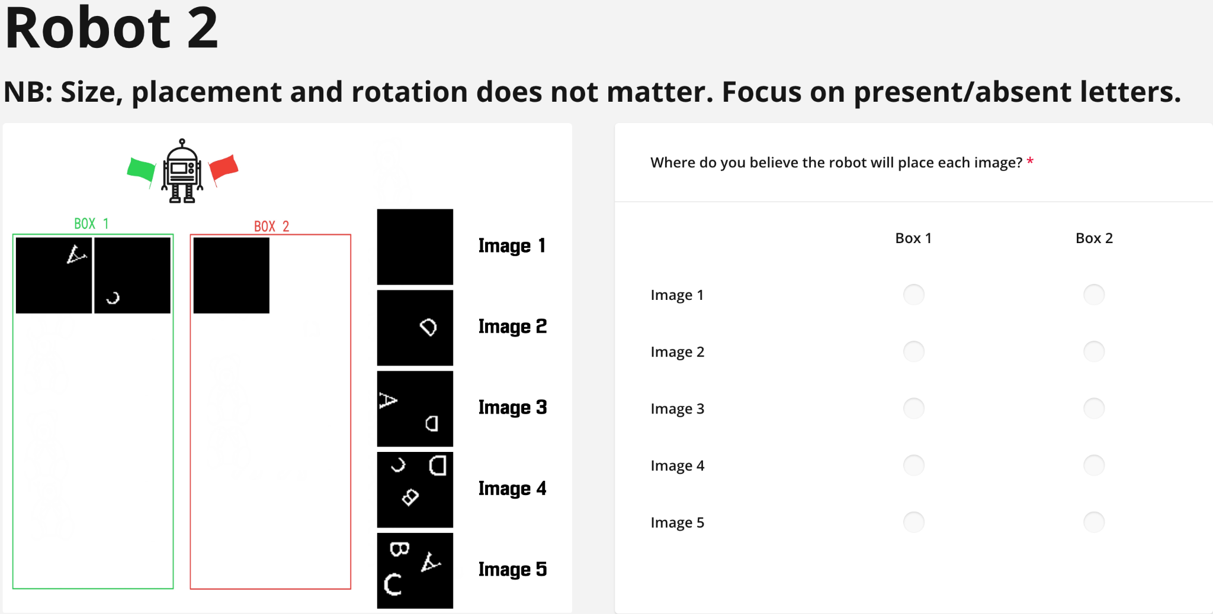
Informed

Slide 55
Accuracy of different groups

Slide 56
Accuracy of different groups
Nothing: 56,4%

Slide 57
Accuracy of different groups
Nothing: 56,4%
Simplified: 66,4%

Slide 58
Accuracy of different groups
Nothing: 56,4%
Simplified: 66,4%
Informed: 73,2%

Slide 59
Human survey 2
Is this system better than randomly drawn examples?
We compare to correctly labeled random teaching sets, of similar size.
Survey groups:
  G_{S}: Smart teaching sets (22)
  G_{R}: Random teaching sets (34)

Slide 60
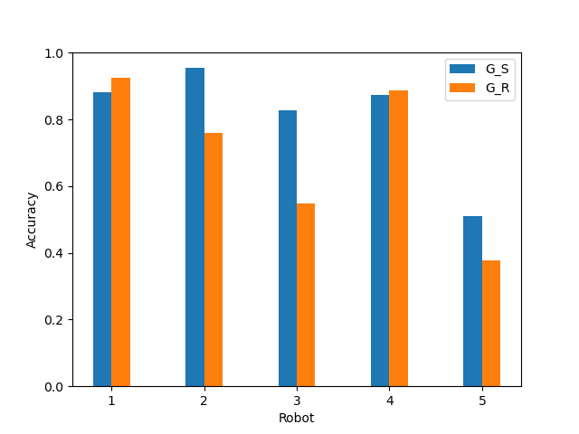
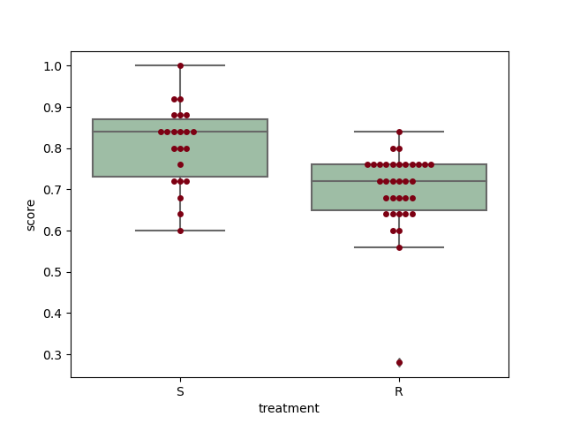
Smart teaching is significantly better

Slide 61
Conclusions and Future Work
Significantly better than random
A good model of human/learner is important
Future work:
  Compare to other exemplar-based techniques
  Improve model of learner
  New domains

Slide 62

Acknowledgments
Paper:
NRC - “Machine Teaching for Explainable AI”
https://xai.w.uib.no/

Slide 63
References
[VALIANT, 84] - Valiant, L.G., “A theory of the learnable”, Communications of the ACM, Vol. 27, No. 11, pp. 1134–1142, 1984.
[Goldman&Mathias, 96] - Sally A. Goldman and H. David Mathias. Teaching a smarter learner. J. Comput. Syst. Sci., 52(2): 255–267, 1996.
[Zhu, 18] - Zhu, X., Singla, A., Zilles, S., Rafferty, A.N.: An overview of machine teaching(2018), http://arxiv.org/abs/1801.05927
[Gao, 17] - Ziyuan Gao, Christoph Ries, Hans U. Simon, and Sandra Zilles. Preference-based teaching. Journal of Machine Learning Research, 18(31):1–32, 2017
[Ferri, 22] - C`esar Ferri, Jos´e Hern´andez-Orallo, and Jan Arne Telle. Non-cheating teaching revisited: A new probabilistic machine teaching model. In Luc De Raedt, editor, Proceedings of the Thirty-First International Joint Conference on Artificial Intelligence, IJCAI 2022, pages 2973–2979, 2022.

Slide 64
Thank you for your attention!

